Slide 1
The Modern Middle East

Slide 2
Post WWII Middle East
The creation of Israel after WWII led to many issues in the Middle East
Sought to achieve political stability and economic growth
War and conflict riddles the region

Slide 3
Israeli-Palestine Conflict
Arab-Israeli dispute over land
In the first 40 years after WWII Israel and Arab states fought 4 wars
Both Jews and Palestinian Arabs claim the land as their religious homeland
With prejudices abroad the world, Jews turned to Zionism
Jewish nationalism advocating that Jews move back to their homeland
Balfour Declaration: Proposed Jewish homeland in Jerusalem in 1917
Led to hostilities between Jews and Arabs

Slide 4
Shocked by the Holocaust after WWII many countries supported a new Israeli state
1947, UN approves plan for a two state solution
States were small and fragmented
Jerusalem was to be under international control by the UN
Both sides disliked the plan
Jews ultimately came to support the idea while Palestinians rejected any notion of a Jewish state

Slide 5
On May 14th, 1948 Israel declared itself an independent state
The next day Egypt, Syria, Jordan, Lebanon, and Iraq invaded Israel
Israel had a well trained army and won by Jan. 1949
Arab states still refused to acknowledge Israel as a free state
In 1956 President Nasser from Egypt seized the Suez Canal
Fastest route from Europe to Asia
Egypt blockaded Israeli shipping

Slide 6
2nd Arab-Israeli war, British and French joined Israel to take back the Suez Canal
Opposition from many countries, including U.S. forced withdrawal
Six-Day War: Nasser closed the Gulf of Aqaba from Israel and declared his goal to destroy Israel
Israel sent fighter jets and lightning fast ground attacks
Israel won a decisive battle in 6 days

Slide 7
After the Six Day War Israel controlled most of the land west of the Jordan River
Including the Gaza Strip
In 1973 Egypt and Syria launched the fourth Arab-Israeli war
Arabs caught Israel off guard by attacking on Yom Kippur, a Jewish holiday
Israel fought back and regained lost territory
Ended with a UN cease fire

Slide 8
Continuing to Struggle
In 1978 President of Egypt Anwar Sadat and Israeli Prime Minister Menachem Begin met for peace talks
Camp David Accords: 1978 peace agreement where Israel returned land taken from Egypt in 1967 and Egypt recognized Israel’s right to exist
3 years later Sadat was assassinated

Slide 9
Palestinians hated the Camp David peace
Wanted control over the Gaza Strip
Palestine Liberation Organization: represented Palestinian interests and pledged to destroy Israel
Israel faced attacks from PLO
Israel struck back against PLO attacks
1993 Oslo Accord: PLO recognizes Israel and Israel granted Palestinian self rule in parts of Gaza and West Bank
Area is still a hotbed of violence to this day

Slide 10
https://www.youtube.com/watch?v=1wo2TLlMhiw

Slide 11
Oil and the Middle East
Iran, Saudi Arabia and Iraq are both part of the Persian Gulf Region
Oil in the region has led to wealth, benefits and conflict
Organization of Petroleum Exporting Countries (OPEC)
Association of gulf nations who produce oil
Aimed to gain control over their own production and set prices

Slide 12
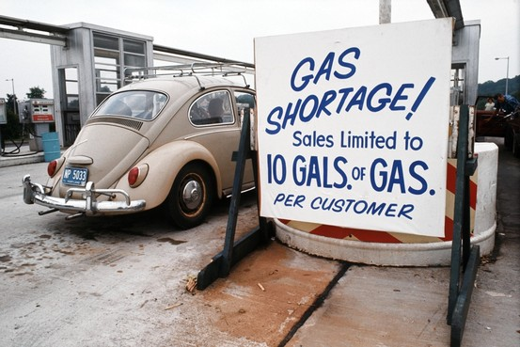
In 1973 OPEC placed an embargo on their oil exports to countries who supported Israel
Known as the Arab Oil Embargo
Lasted 6 months and caused mass oil shortages in the U.S. and western states
Prices of oil skyrocketed
Gulf countries saw their wealth soar

Slide 13
Used money to build militaries which led to tensions in the region
Iraq’s revenue soared and Saddam Hussein wanted to increase the countries power
Saddam invaded Iran in 1980
Largely a stalemate for 8 years
Cease fire signed in 1988
Nearly 1 million had been killed

Slide 14
Persian Gulf War
Two years after the cease fire Saddam invaded Kuwait
Quickly captured the capital of Kuwait City
Saddam seized Kuwaits oil and assets
UN put sanctions on Iraq and Saudi Arabia called for a counter strike
U.S. led a coalition force from many countries including GB, France and many Middle Eastern nations

Slide 15
Saddam was given a deadline of January 15th, 1991 to get out of Kuwait
He refused and the Persian Gulf War began
The next day the coalition force began an aerial attack on Iraq
5 weeks later the ground war began
In just 4 days the coalition force won

